Slide 1


Git Going
A Crash Course in Git and GitHub
Penn State Harrisburg
IEEE & Computing and AI club
Git Going – A Crash Course in Git and GitHub

Slide 2
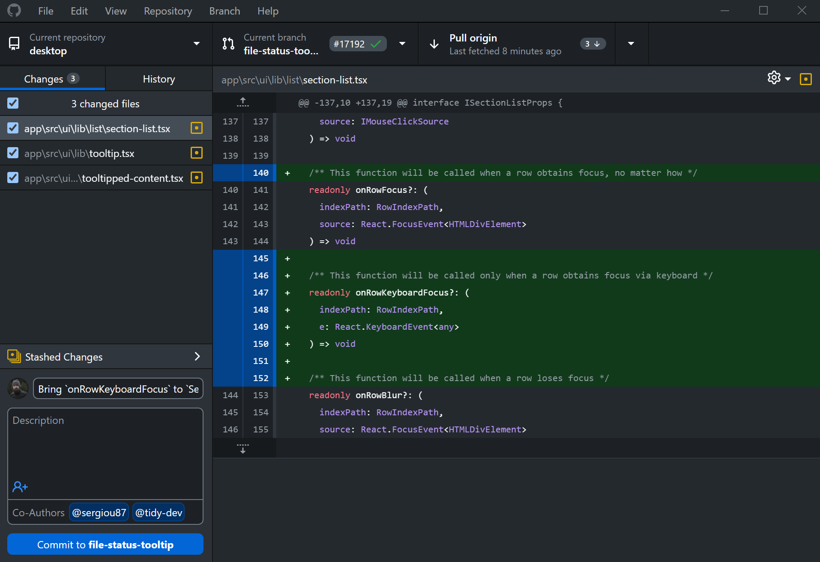
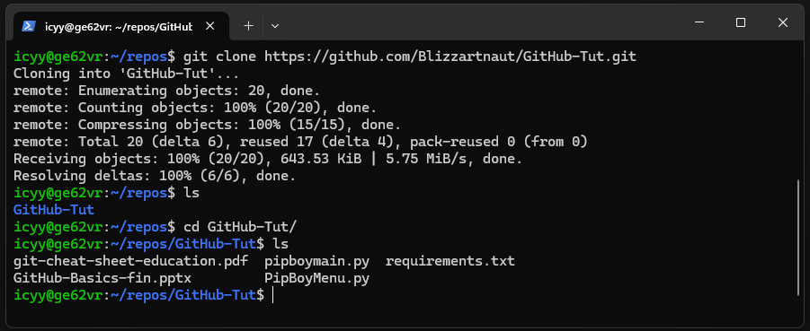
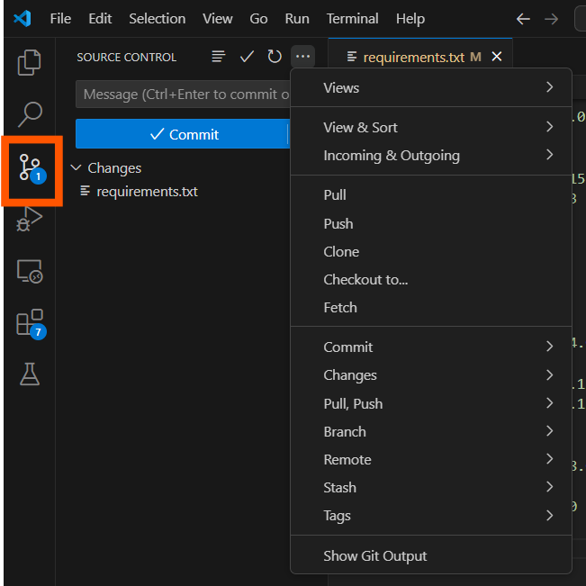
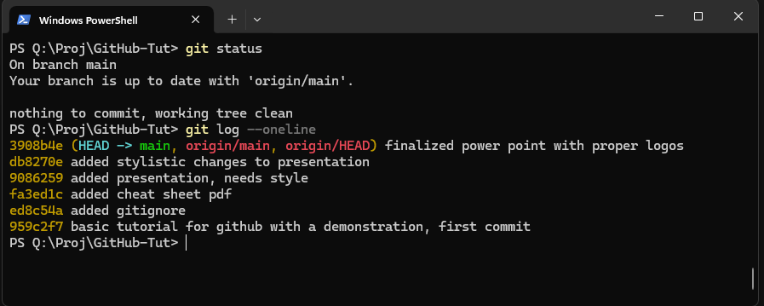
Installing Git
Command-line Client (CLI)
https://git-scm.com/downloads
Graphical Client (GUI)
https://desktop.github.com/download
Or use the one in your IDE!
(Linux Terminal)
(Windows PowerShell)
(GitHub Desktop)
(VS Code)
Penn State Harrisburg
IEEE & Computing and AI club
Git Going – A Crash Course in Git and GitHub

Slide 3
Intro: Version Control and Git
Version Control helps track changes you make in your code, and when collaborating with other programmers such as in a company environment allows you to keep track of everyone’s changes.
This allows for a mostly smooth experience of ensuring everyone is on the same page when programming.
Its also important for engineers of all kinds for dealing with documentation, simulations, CAD files, or data analysis scripts.
Penn State Harrisburg
IEEE & Computing and AI club
Git Going – A Crash Course in Git and GitHub

Slide 4



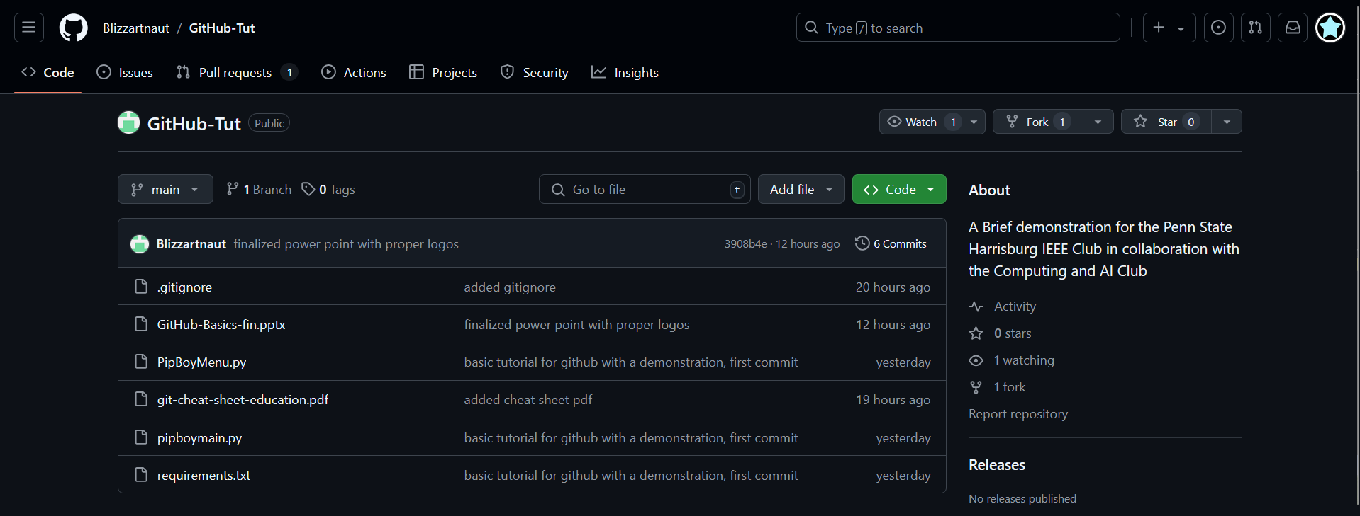
Git != GitHub
Git: A distributed version control system, based on “snapshots” of your code
Manages your source code
Helps with collaboration
GitHub: A web-based hosting service for Git repositories allowing one to share their repositories with others.
A Hub for Git projects. GitHub.
Other platforms exist (GitLab, Gitea, etc.)
Linus Torvalds
Penn State Harrisburg
IEEE & Computing and AI club
Git Going – A Crash Course in Git and GitHub

Slide 5
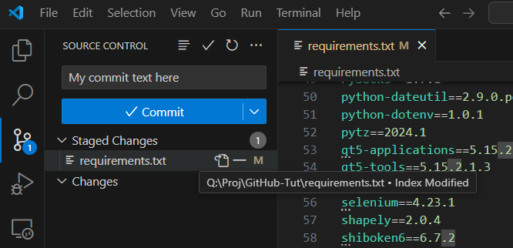
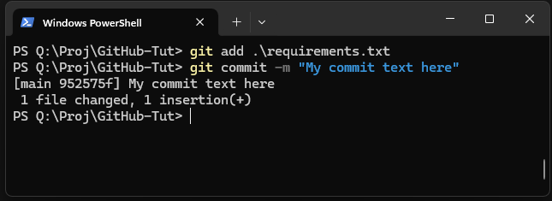
Git GUIs
Convenient visual Git clients
But they’re just wrappers for the Git CLI
Same as
Penn State Harrisburg
IEEE & Computing and AI club
Git Going – A Crash Course in Git and GitHub

Slide 6
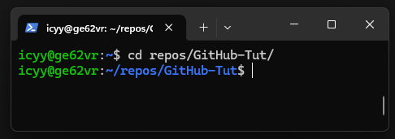
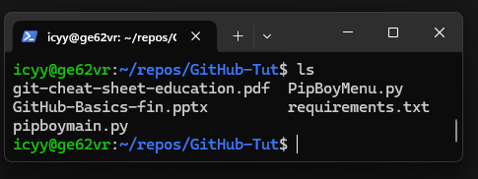
Quick Terminal Basics
Change Directories with cd .
List the files in your current directory with ls .
Penn State Harrisburg
IEEE & Computing and AI club
Git Going – A Crash Course in Git and GitHub

Slide 7
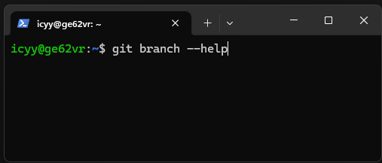
Quick Terminal Tips
All commands have --help .
You can also search for help online, or have chat AIs explain commands
Penn State Harrisburg
IEEE & Computing and AI club
Git Going – A Crash Course in Git and GitHub

Slide 8
Setting Up Git: Local Configuration
After installation set up your local git basic settings
If you already have git you can ignore the steps on this page.
Configure Username: (Type in terminal)
git config --global user.name “YourUsernameHere” .
Configure Email associated with your account (Type in terminal)
git config --global user.email “YourEmail@somewhere.com” .
Your config gets saved to a file named .gitconfig in your user/home folder.
Penn State Harrisburg
IEEE & Computing and AI club
Git Going – A Crash Course in Git and GitHub

Slide 9
Git Basics: Definitions
Working Directory: The actual directory where project files are located, modifications made to files in the working directory are considered ‘untracked’ until staged for commit.
Repository: “Repo”, the database for all committed files, managing and tracking changes in files.
Penn State Harrisburg
IEEE & Computing and AI club
Git Going – A Crash Course in Git and GitHub

Slide 10
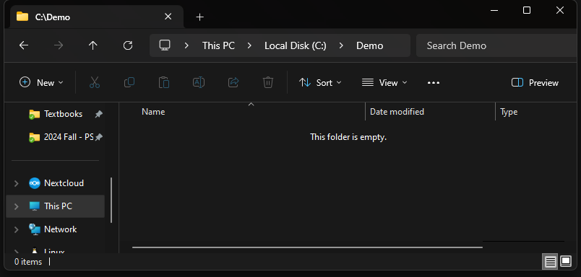
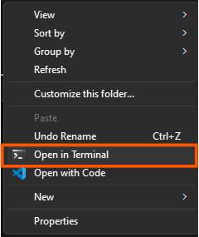
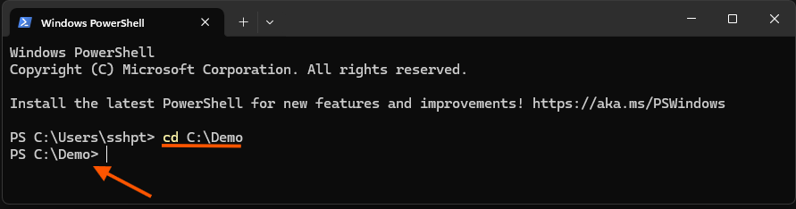
Creating a local Repo
with the file explorer
Navigate to a folder using your file explorer
Or use just the terminal
without the file explorer
Penn State Harrisburg
IEEE & Computing and AI club
Git Going – A Crash Course in Git and GitHub

Slide 11
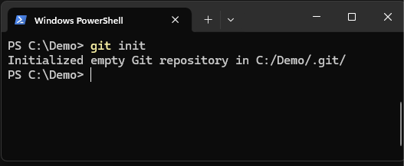
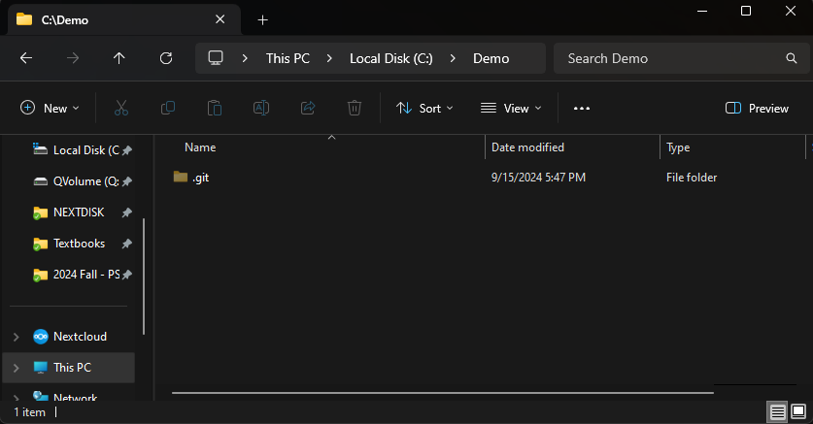
Creating a local Repo
To create a new git repo, use git init .
This creates a hidden .git folder that contains Git’s data.
You can use this on blank or full folders. Anything can be a repository!
⚠️ Don’t follow this yet!
We’re about to use git clone instead.
Penn State Harrisburg
IEEE & Computing and AI club
Git Going – A Crash Course in Git and GitHub

Slide 12
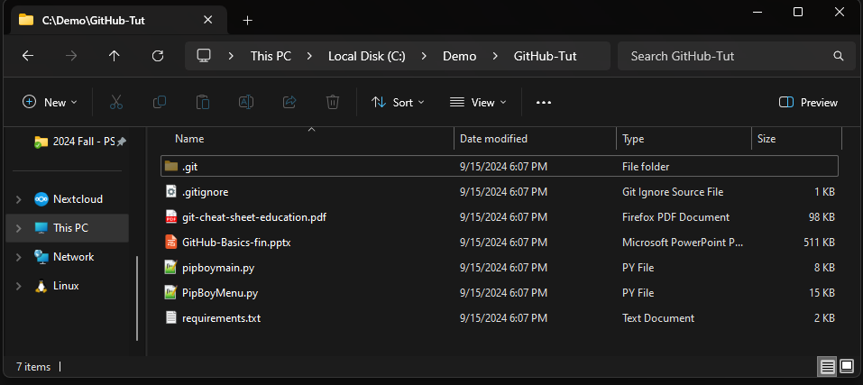
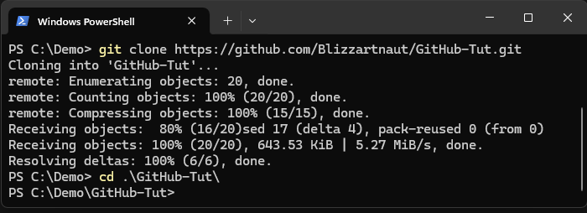
Cloning a Repo
To clone an existing repo, use git clone <url-to-repo> .
This creates a new folder with the repository’s latest contents
As a demo, please run on your machine:
git clone https://github.com/Blizzartnaut/GitHub-Tut.git .
Penn State Harrisburg
IEEE & Computing and AI club
Git Going – A Crash Course in Git and GitHub

Slide 13
Commits
A commit is a “snapshot” of your source code
A commit has:
A Snapshot (Of your files)
A Message ( git commit –m “Your Fancy Message” )
An Author (Name & Email)
Parent commits (Can be multiple!)
Each commit is identified by a SHA-1 Hash
Penn State Harrisburg
IEEE & Computing and AI club
Git Going – A Crash Course in Git and GitHub

Slide 14
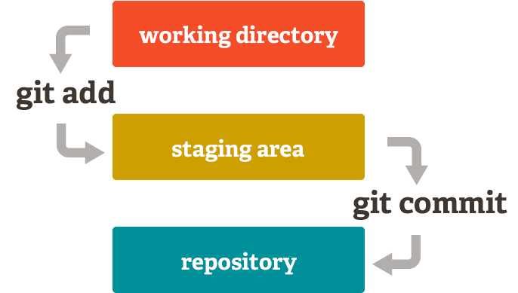
Tracking Changes
To check the difference between your working directory and the HEAD
git status .
Add files to the staging area
git add file_name .
Create a new commit
git commit –m “commit message” .
Penn State Harrisburg
IEEE & Computing and AI club
Git Going – A Crash Course in Git and GitHub

Slide 15
View commit history
To display commit logs, use git log .
Displays in reverse chronological order (Higher is newer)
Press Q to quit the pager
Very customizable! Useful flags:
git log --oneline . (Just the info you need)
git log --graph . (Shows branch merges really well)
git log --all . (Shows commits from other branches)
git log --decorate . (Shows ref names, enabled by default on newer versions)
Penn State Harrisburg
IEEE & Computing and AI club
Git Going – A Crash Course in Git and GitHub

Slide 16
View commit history
To display commit logs, use git log .
Displays in reverse chronological order (Higher is newer)
Press Q to quit the pager
Very customizable! Useful flags:
git log --oneline . (Just the info you need)
git log --graph . (Shows branch merges really well)
git log --all . (Shows commits from other branches)
git log --decorate . (Shows ref names, enabled by default on newer versions)
You can combine flags!
git log --all --decorate --oneline --graph .
Use this quickly with aliases! To set this up, use:
git config --global alias.logadog log --all --decorate --oneline --graph .
And then you can just call git logadog .🐕
Penn State Harrisburg
IEEE & Computing and AI club
Git Going – A Crash Course in Git and GitHub

Slide 17
References and Tags
Using SHA-1 hashes to reference a commit isn’t fun
There’s built in, human readable names that point toward specific commits
Branch names (e.g. main)
Tags, made by you or others (e.g. v1.0.0, v6.11)
HEAD - Your current branch’s latest commit
FETCH_HEAD - The remote branch’s latest commit
and more that don’t belong in an intro to Git workshop…
You can grab nearby commits using ~ and ^
HEAD^ or HEAD~1 – One commit before HEAD
Can get complicated, just read the friendly manual if you need something fancy ;)
Penn State Harrisburg
IEEE & Computing and AI club
Git Going – A Crash Course in Git and GitHub

Slide 18
Differences between two commits
To compare differences between commits or references
git diff commitA..commitB . (Difference between A and B)
git diff commitA..HEAD . (Difference between A and HEAD)
git diff main..some-feature-branch . (Difference between two branches)
git diff HEAD^1..HEAD . (Relative references work too!)
Mix and match!
Relative references work too!
Penn State Harrisburg
IEEE & Computing and AI club
Git Going – A Crash Course in Git and GitHub

Slide 19
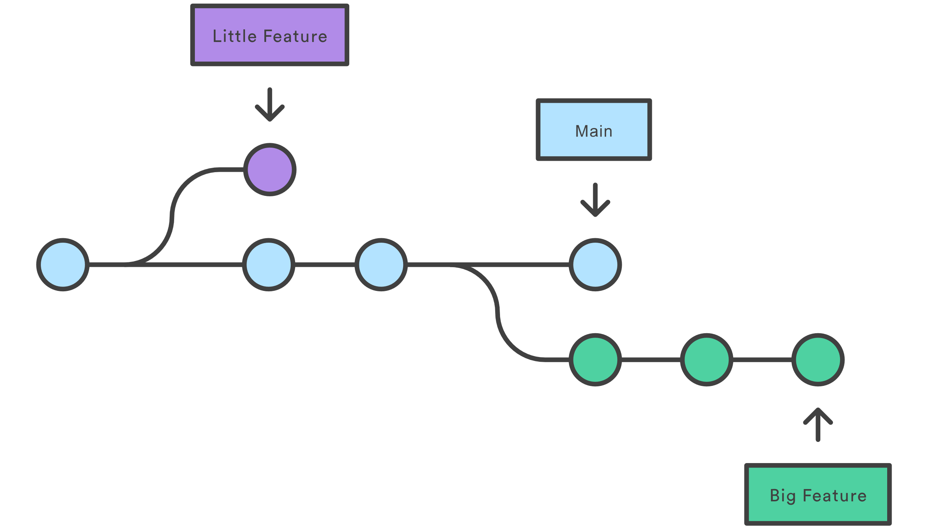
Branching Basics
Branches are pointers to commits, and helps working in parallel
Different projects have different naming/working standards
Show existing branches git branch .
Create a new branch named new_feature git branch new_feature .
Switch to branch git checkout new_feature .
Create AND switch to branch git checkout –b new_feature .
Penn State Harrisburg
IEEE & Computing and AI club
Git Going – A Crash Course in Git and GitHub

Slide 20
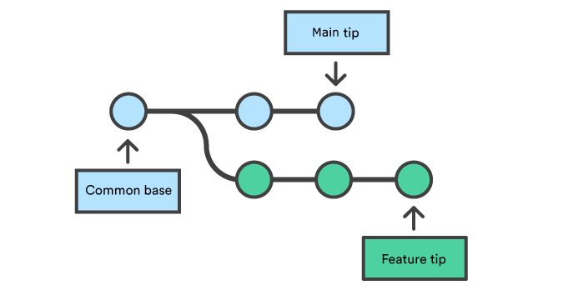
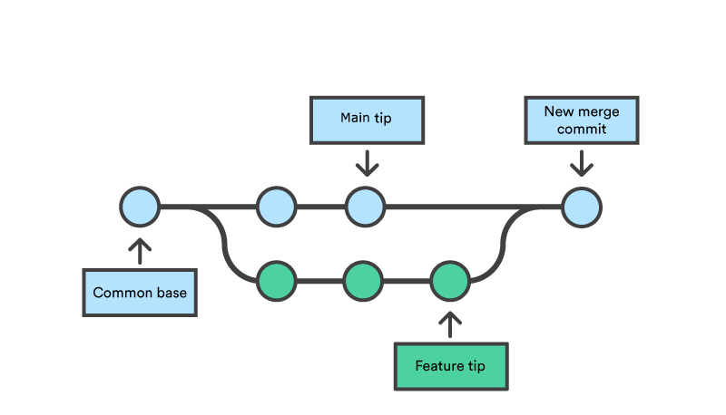
Git Merge
Once you’re done working on a branch, it’s time to merge it. Git will handle wedging your changes into the existing codebase.
Checkout the branch you want to merge on to git checkout main .
Merge the branch git merge new_feature .
Merged successfully? You can now delete your branch git branch –d new_feature .
Sometimes, merges don’t go smoothly…
Penn State Harrisburg
IEEE & Computing and AI club
Git Going – A Crash Course in Git and GitHub

Slide 21
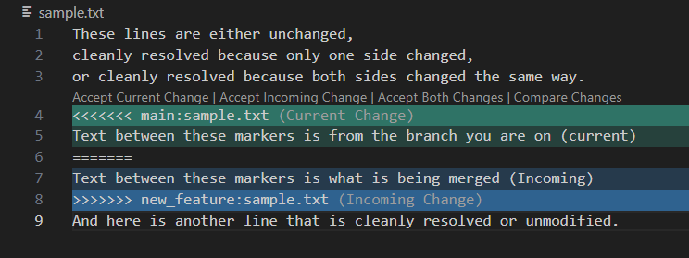
Merge Conflicts
If Git can’t cleanly merge, it will add markers to your file and let you know that there’s a merge conflict.
You will need to manually resolve the conflict to finish the merge
The conflict is just text, you can either edit the file yourself or have your IDE help find and solve conflicts with one click
git add . and git commit . Once you’re done resolving. Merge complete!
Penn State Harrisburg
IEEE & Computing and AI club
Git Going – A Crash Course in Git and GitHub

Slide 22
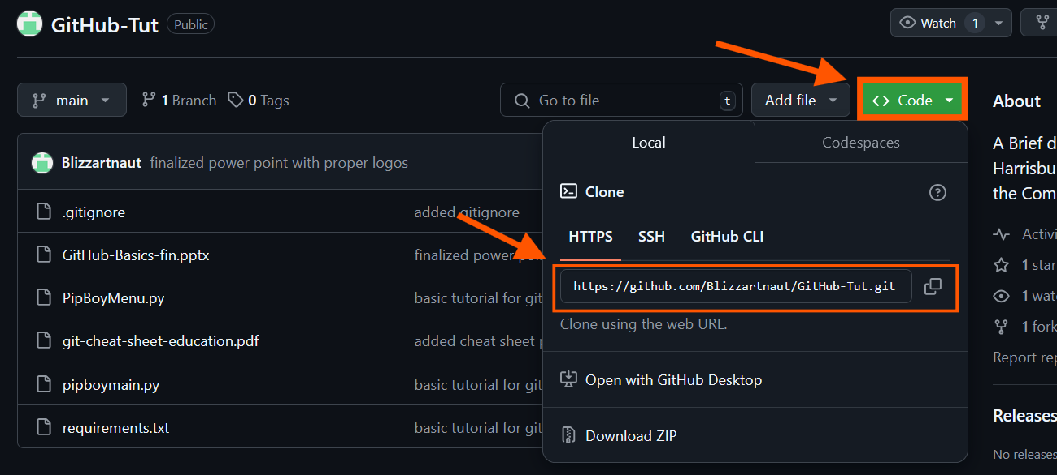
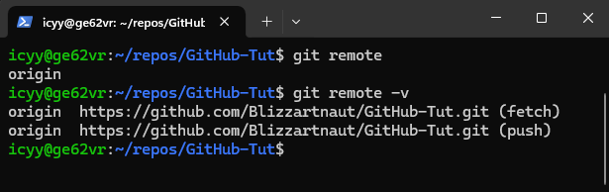
Remote Repositories
Remotes offer a way to push the contents of your repository somewhere else, or pull the latest to your repository
Automatically set if you use git clone .
git remote . to view remotes
git remote -v . to see URLs
git remote add <remote_name> <URL> .
to add another remote
Penn State Harrisburg
IEEE & Computing and AI club
Git Going – A Crash Course in Git and GitHub

Slide 23
Fetch, Pull, and Push
As commits get pushed to the remote, you can use git fetch to tell Git to fetch the latest changes.
Perform a pull to add the latest commits to one of your branches git pull <remote> <branch> (example: git pull origin main )
Note: git pull also runs git fetch !
Push your changes to the remote once you’re ready git push <remote> <branch> (example: git push origin main )
Note: Using git push –u <remote> <branch> lets you use git pull without any arguments!
Penn State Harrisburg
IEEE & Computing and AI club
Git Going – A Crash Course in Git and GitHub

Slide 24
Pipboy project Demonstration
git clone https://github.com/Blizzartnaut/GitHub-Tut .
python –m venv demo .
python demo/Scripts/activate .
pip install –r ./requirements.txt .
python PipBoyMenu.py .
Penn State Harrisburg
IEEE & Computing and AI club
Git Going – A Crash Course in Git and GitHub

